Slide 1
Capstone Proposals

Slide 2
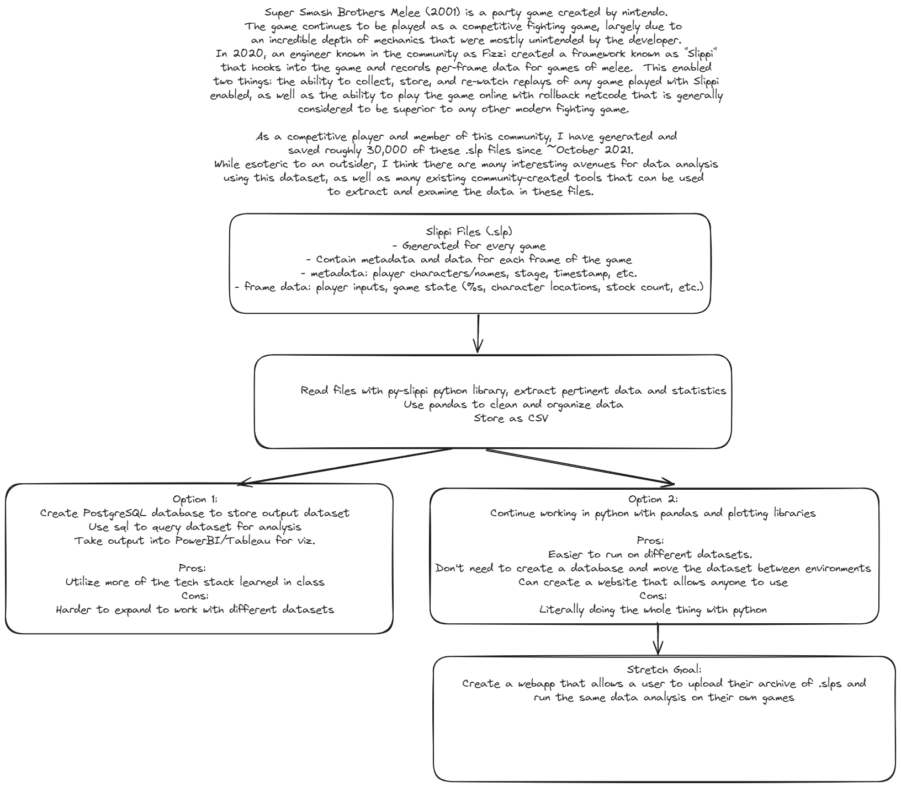

Slide 3
